Slide 1
CSE 6179
Digital Forensics
Lecture 1
Introduction to Digital Forensics
Mohammad Mamun Elahi
Assistant Professor, Dept. of CSE

Slide 2
Objectives
  Forensic definitions
  Forensic Investigation
  Main forensic concepts
  Steps for conducting an Investigation

Slide 3
Definitions
Forensic:
  “…a characteristic of evidence that satisfies its suitability for admission as fact and its ability to persuade based upon proof (or high statistical confidence).”
The aim of forensic science is:
  “…to demonstrate how digital evidence can be used to reconstruct a crime or incident, identify suspects, apprehend the guilty, defend the innocent, and understand criminal motivations.”
Ref: Casey, “Digital Evidence and Computer Crime”

Slide 4
Computer Forensics vs Digital Forensics
“Computer forensics is simply the application of computer investigation and analysis
techniques in the interests of determining potential legal evidence. Evidence might be sought in a wide range of computer crime or misuse, including but not limited to theft of trade secrets, theft of or destruction of intellectual property, and fraud.”
Robbins, Judd , PC Software Forensics
The use of scientifically derived and proven methods towards the preservation, collection, validation, identification, analysis, interpretation, documentation, and presentation of digital evidence derived from the digital sources for the purpose of facilitation or furthering the reconstruction of events found to be criminal, or helping to anticipate unauthorized actions shown to be disruptive to planned operations.
Digital Forensics Research Workshop

Slide 5
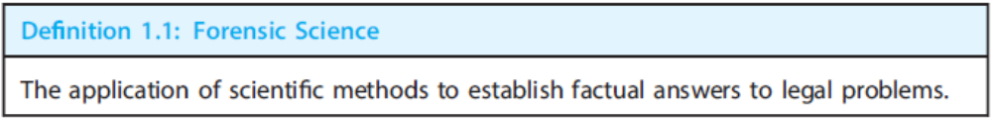
Forensic Science
– “Application of physical sciences to law in the search for truth in civil, criminal and social behavioral matters to the end that injustice shall not be done to any member of society”
  (Source: Handbook of Forensic Pathology College of American Pathologists 1990)
– Aim: determining the evidential value of crime scene and related evidence
Notes:
Thus, what we are not going to learn is how to give evidence in court, what the specific laws are in relation to computer misuse. Nor are we going to cover the various organisational policies that you may encounter.
Instead, we are here to focus solely on the area of digital investigation. Evidence, thus, has a meaning in investigative context, and not in terms of the context of legal admissibility.
Thus this leads to the idea that digital investigation is influenced by the context in which it is undertaken. This module is concerned with Digital investigation. The outcome of this investigation may be used for a Forensic Investigation as part of a criminal case against an individual, or it may be used as part of an internal process. This is something that we are not going to teach as part of this course, as it is out of our remit.

Slide 6
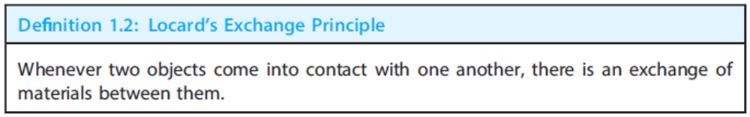
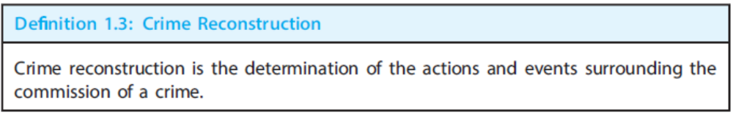
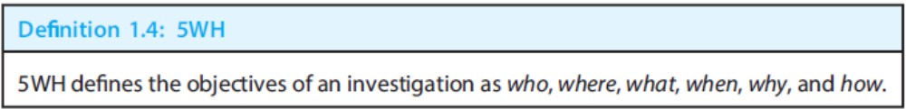
Forensic Science
More definitions
Notes:
Thus, what we are not going to learn is how to give evidence in court, what the specific laws are in relation to computer misuse. Nor are we going to cover the various organisational policies that you may encounter.
Instead, we are here to focus solely on the area of digital investigation. Evidence, thus, has a meaning in investigative context, and not in terms of the context of legal admissibility.
Thus this leads to the idea that digital investigation is influenced by the context in which it is undertaken. This module is concerned with Digital investigation. The outcome of this investigation may be used for a Forensic Investigation as part of a criminal case against an individual, or it may be used as part of an internal process. This is something that we are not going to teach as part of this course, as it is out of our remit.

Slide 7
5WH
Who: Persons involved in the investigation, including suspects, witnesses, and victims
Where: The location of the crime and other relevant locations
What: Description of the facts of the crime in question
When: The time of the crime and other related events
Why: The motivation for the crime and why it happened at a given time
How: How the crime was committed.
Notes:
Thus, what we are not going to learn is how to give evidence in court, what the specific laws are in relation to computer misuse. Nor are we going to cover the various organisational policies that you may encounter.
Instead, we are here to focus solely on the area of digital investigation. Evidence, thus, has a meaning in investigative context, and not in terms of the context of legal admissibility.
Thus this leads to the idea that digital investigation is influenced by the context in which it is undertaken. This module is concerned with Digital investigation. The outcome of this investigation may be used for a Forensic Investigation as part of a criminal case against an individual, or it may be used as part of an internal process. This is something that we are not going to teach as part of this course, as it is out of our remit.

Slide 8
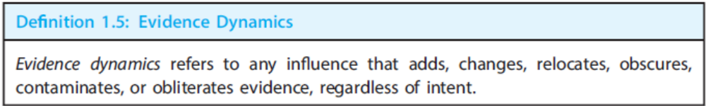
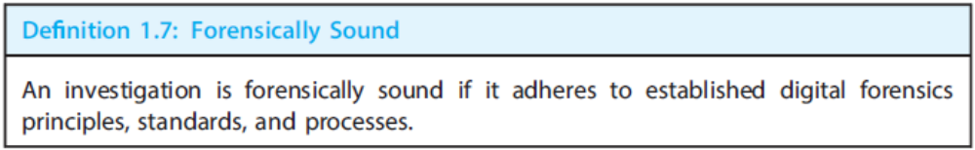
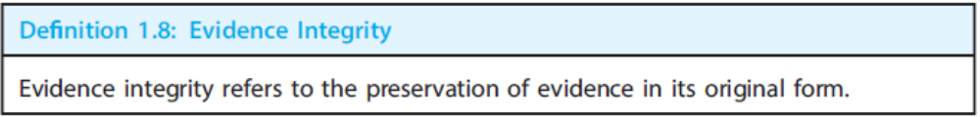
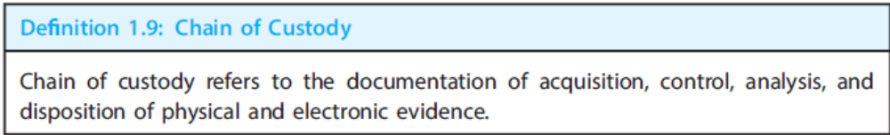
Some more definitions
Notes:
Thus, what we are not going to learn is how to give evidence in court, what the specific laws are in relation to computer misuse. Nor are we going to cover the various organisational policies that you may encounter.
Instead, we are here to focus solely on the area of digital investigation. Evidence, thus, has a meaning in investigative context, and not in terms of the context of legal admissibility.
Thus this leads to the idea that digital investigation is influenced by the context in which it is undertaken. This module is concerned with Digital investigation. The outcome of this investigation may be used for a Forensic Investigation as part of a criminal case against an individual, or it may be used as part of an internal process. This is something that we are not going to teach as part of this course, as it is out of our remit.

Slide 9
Need for Computer Forensics
“Computer forensics is equivalent of surveying a crime scene or performing an autopsy on a victim”. {Source: James Borek 2001}
Presence of a majority of electronic documents nowadays
Search and identify data in a computer
Digital Evidence is delicate in nature
For recovering
  Deleted,
  Encrypted , or,
  Corrupted files from a system
Notes:
Thus, what we are not going to learn is how to give evidence in court, what the specific laws are in relation to computer misuse. Nor are we going to cover the various organisational policies that you may encounter.
Instead, we are here to focus solely on the area of digital investigation. Evidence, thus, has a meaning in investigative context, and not in terms of the context of legal admissibility.
Thus this leads to the idea that digital investigation is influenced by the context in which it is undertaken. This module is concerned with Digital investigation. The outcome of this investigation may be used for a Forensic Investigation as part of a criminal case against an individual, or it may be used as part of an internal process. This is something that we are not going to teach as part of this course, as it is out of our remit.

Slide 10
Cyber Crime
“Any illegal act involving a computer, its systems, or its applications”
The crime must be intentional and not accidental.
Two types of Attacks:
  Insider Attacks
  Outsider Attacks
Cyber crime is divided into 3 T’s
  Tools of the crime
  Target of the crime
  Tangential to the crime
Notes:
Thus, what we are not going to learn is how to give evidence in court, what the specific laws are in relation to computer misuse. Nor are we going to cover the various organisational policies that you may encounter.
Instead, we are here to focus solely on the area of digital investigation. Evidence, thus, has a meaning in investigative context, and not in terms of the context of legal admissibility.
Thus this leads to the idea that digital investigation is influenced by the context in which it is undertaken. This module is concerned with Digital investigation. The outcome of this investigation may be used for a Forensic Investigation as part of a criminal case against an individual, or it may be used as part of an internal process. This is something that we are not going to teach as part of this course, as it is out of our remit.

Slide 11
Tracking Cyber Criminals
Identifying the crime
Gathering the evidence
Building a chain of custody
Analyzing the evidence
Presenting the evidence
Testifying
Prosecution
Notes:
Thus, what we are not going to learn is how to give evidence in court, what the specific laws are in relation to computer misuse. Nor are we going to cover the various organisational policies that you may encounter.
Instead, we are here to focus solely on the area of digital investigation. Evidence, thus, has a meaning in investigative context, and not in terms of the context of legal admissibility.
Thus this leads to the idea that digital investigation is influenced by the context in which it is undertaken. This module is concerned with Digital investigation. The outcome of this investigation may be used for a Forensic Investigation as part of a criminal case against an individual, or it may be used as part of an internal process. This is something that we are not going to teach as part of this course, as it is out of our remit.

Slide 12
Rules of Computer Forensics
Minimize the option of examining the original Evidence
Obey rules of evidence
Never exceed the knowledge base
Document any changes in evidence
Notes:
Thus, what we are not going to learn is how to give evidence in court, what the specific laws are in relation to computer misuse. Nor are we going to cover the various organisational policies that you may encounter.
Instead, we are here to focus solely on the area of digital investigation. Evidence, thus, has a meaning in investigative context, and not in terms of the context of legal admissibility.
Thus this leads to the idea that digital investigation is influenced by the context in which it is undertaken. This module is concerned with Digital investigation. The outcome of this investigation may be used for a Forensic Investigation as part of a criminal case against an individual, or it may be used as part of an internal process. This is something that we are not going to teach as part of this course, as it is out of our remit.

Slide 13
Computer Forensic Methodologies
The 3 A’s
  Acquire evidence without modification or corruption
  Authenticate that the recovered evidence is same as the originally seized data
  Analyze data without any alterations
Notes:
Thus, what we are not going to learn is how to give evidence in court, what the specific laws are in relation to computer misuse. Nor are we going to cover the various organisational policies that you may encounter.
Instead, we are here to focus solely on the area of digital investigation. Evidence, thus, has a meaning in investigative context, and not in terms of the context of legal admissibility.
Thus this leads to the idea that digital investigation is influenced by the context in which it is undertaken. This module is concerned with Digital investigation. The outcome of this investigation may be used for a Forensic Investigation as part of a criminal case against an individual, or it may be used as part of an internal process. This is something that we are not going to teach as part of this course, as it is out of our remit.

Slide 14
Professional Conduct and Ethics
Professional conduct determines the credibility of a forensic investigator
Investigators must display the highest level of ethics and moral integrity
Confidentiality is an essential feature which all forensic investigators must display
Discuss the case at hand only with person who has the right to know
Notes:
Thus, what we are not going to learn is how to give evidence in court, what the specific laws are in relation to computer misuse. Nor are we going to cover the various organisational policies that you may encounter.
Instead, we are here to focus solely on the area of digital investigation. Evidence, thus, has a meaning in investigative context, and not in terms of the context of legal admissibility.
Thus this leads to the idea that digital investigation is influenced by the context in which it is undertaken. This module is concerned with Digital investigation. The outcome of this investigation may be used for a Forensic Investigation as part of a criminal case against an individual, or it may be used as part of an internal process. This is something that we are not going to teach as part of this course, as it is out of our remit.

Slide 15
Crime Reconstruction in Digital Forensics
Evidence examination: Identify and characterize evidence relevant to an incident.
Role classification: Examine the role of the evidence as a cause or effect of an event.
Event construction and testing: Identify events and assess whether they are possible.
Event sequencing: Combine events into event chains.
Hypothesis testing: The hypothesis is tested using the scientific method.
Notes:
Thus, what we are not going to learn is how to give evidence in court, what the specific laws are in relation to computer misuse. Nor are we going to cover the various organisational policies that you may encounter.
Instead, we are here to focus solely on the area of digital investigation. Evidence, thus, has a meaning in investigative context, and not in terms of the context of legal admissibility.
Thus this leads to the idea that digital investigation is influenced by the context in which it is undertaken. This module is concerned with Digital investigation. The outcome of this investigation may be used for a Forensic Investigation as part of a criminal case against an individual, or it may be used as part of an internal process. This is something that we are not going to teach as part of this course, as it is out of our remit.

Slide 16
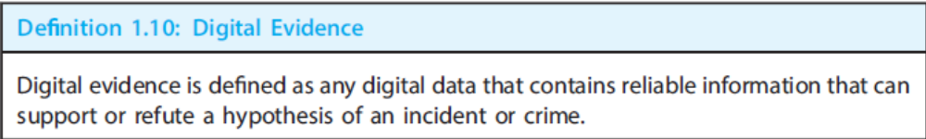
Digital Investigation
A digital investigation is a process where we develop and test hypotheses that answer questions about digital events. This is done using the scientific method where we develop a hypothesis using evidence that we find and then test the hypothesis by looking for additional evidence that shows the hypothesis is impossible.
Digital Evidence is a digital object that contains reliable information that supports or refutes a hypothesis.
B. Carrier, 2006
File System Forensic Analysis,
Notes:
Thus, what we are not going to learn is how to give evidence in court, what the specific laws are in relation to computer misuse. Nor are we going to cover the various organisational policies that you may encounter.
Instead, we are here to focus solely on the area of digital investigation. Evidence, thus, has a meaning in investigative context, and not in terms of the context of legal admissibility.
Thus this leads to the idea that digital investigation is influenced by the context in which it is undertaken. This module is concerned with Digital investigation. The outcome of this investigation may be used for a Forensic Investigation as part of a criminal case against an individual, or it may be used as part of an internal process. This is something that we are not going to teach as part of this course, as it is out of our remit.

Slide 17
Characteristics of Evidence
Data can be viewed at different levels of abstraction
Data requires interpretation
Data is Fragile
Data is Voluminous
Data is difficult to associate with reality
Notes:
Why is this a challenging discipline? Not only are the systems upon which we are working highly complex, but the evidence we collect has the following characteristics.

Slide 18
Investigation Process
According to many professionals, Computer Forensics is a four (4) step process:
  Acquisition
    Physically or remotely obtaining possession of the computer, all network mappings from the system, and external physical storage devices
  Identification
    This step involves identifying what data could be recovered and electronically retrieving it by running various Computer Forensic tools and software suites
  Evaluation
    Evaluating the information/data recovered to determine if and how it could be used again the suspect for employment termination or prosecution in court
  Presentation
    This step involves the presentation of evidence discovered in a manner which is understood by lawyers, non-technically staff/management, and suitable as evidence as determined by United States and internal laws

Slide 19
Conducting an Investigation
Gather resources identified in investigation plan
Items needed:
  Original storage media
  Evidence custody form
  Evidence container for the storage media
  Bit-stream imaging tool
  Forensic workstation to copy and examine your evidence
  Securable evidence locker, cabinet, or safe

Slide 20
Gathering the Evidence
Avoid damaging the evidence
Steps:
  Meet the IT manager to interview him
  Fill out the evidence form, have the IT manager sign
  Place the evidence in a secure container
  Carry the evidence to the computer forensics lab
  Complete the evidence custody form
  Secure evidence by locking the container

Slide 21
Understanding Bit-Stream Copies (1/2)
Bit-stream copy
  Bit-by-bit copy of the original storage medium
  Exact copy of the original disk
  Different from a simple backup copy
    Only copy known files
    Cannot copy deleted files, e-mail messages or recover file fragments
Bit-stream image
  File containing the bit-stream copy of all data on a disk or partition
  Also known as “image” or “image file”
Copy image file to a target disk that matches the original disk’s manufacturer, size and model

Slide 22
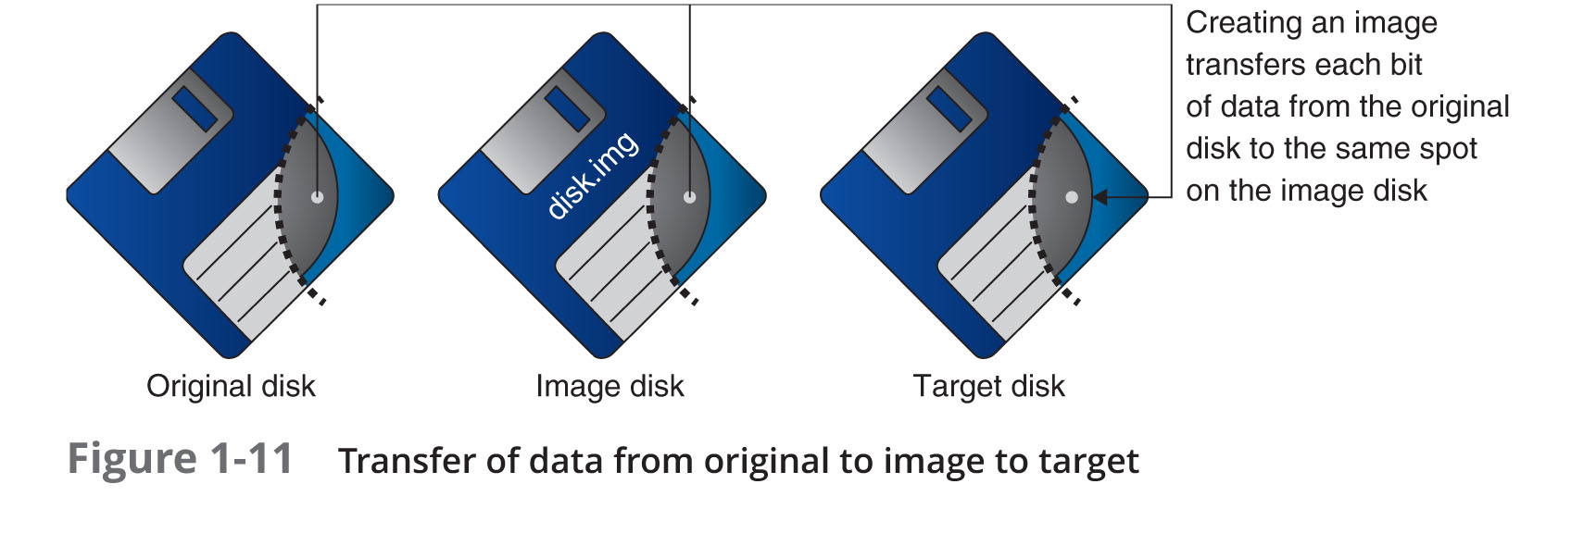
Understanding Bit-Stream Copies (2/2)

Slide 23
Acquiring an Image of Evidence Media
First rule of computer forensics
  Preserve the original evidence
Conduct your analysis only on a copy of the data
Several vendors provide MS-DOS, Linux, and Windows acquisition tools
  Windows tools require a write-blocking device when acquiring data from FAT or NTFS file systems

Slide 24
Analyzing Your Digital Evidence (1/8)
Your job is to recover data from:
  Deleted files
  File fragments
  Complete files
Deleted files linger on the disk until new data is saved on the same physical location
Tools can be used to retrieve deleted files
  Autopsy

Slide 25
Analyzing Your Digital Evidence (2/8)
Steps to analyze a USB drive
  Start Autopsy
  Create a new case
  Type the case name
  Select the working folder
Steps to add source data
  Select data source type
  Select image file
  Keep the default settings in the Configure Ingest Modules window

Slide 26
Analyzing Your Digital Evidence (3/8)
Steps to display the contents of the acquired data
  Click to expand Views, File Types, By Extension, and Documents
  Select file to display
  Click Tag and Comment
  Click the New Tag Name button
Analyze the data
  Search for information related to the complaint
Data analysis can be most time-consuming task

Slide 27
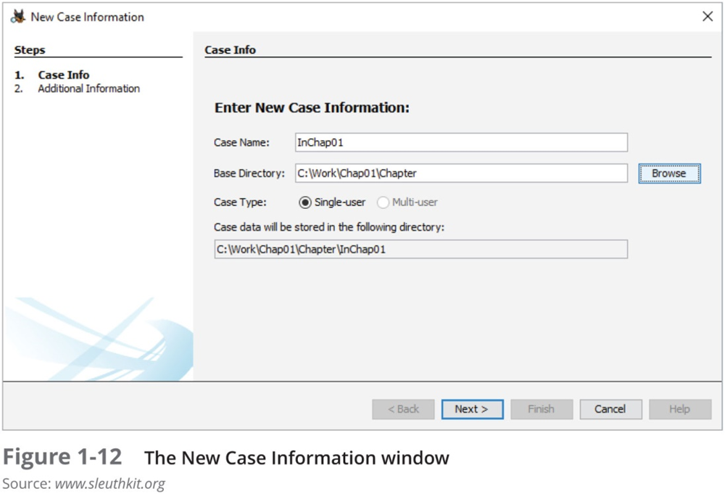
Analyzing Your Digital Evidence (4/8)

Slide 28
Analyzing Your Digital Evidence (5/8)
With Autopsy you can:
  Search for keywords of interest in the case
  Display the results in a search results window
  Click each file in the search results window and examine its content in the data area
  Export the data to a folder of your choice
  Search for specific filenames
  Generate a report of your activities
Additional features of Autopsy
  Display binary (nonprintable) data in the Content Viewer

Slide 29
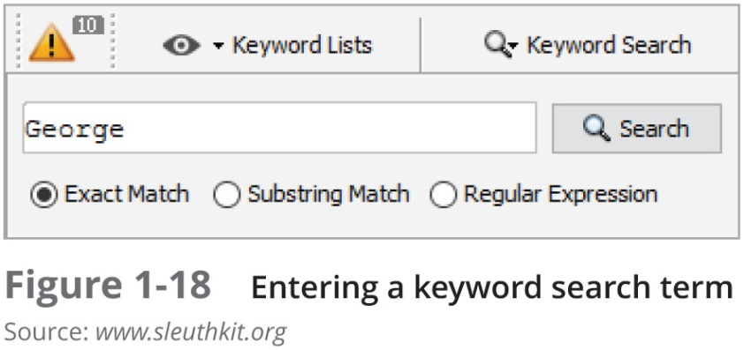
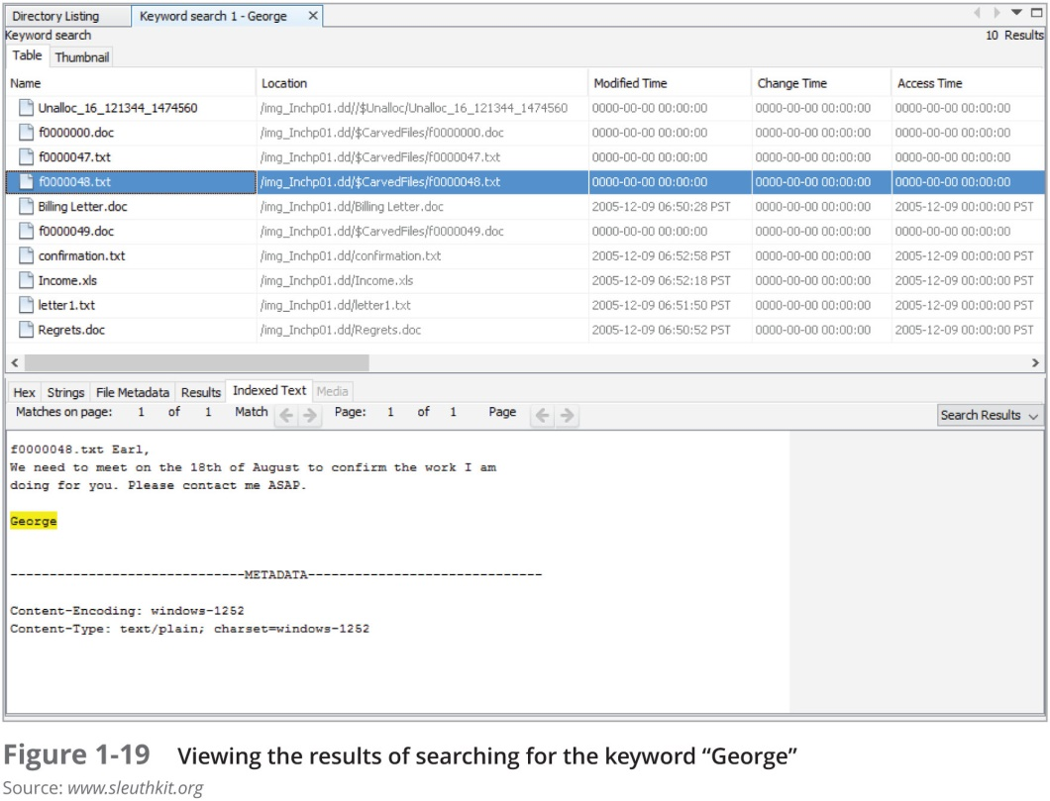
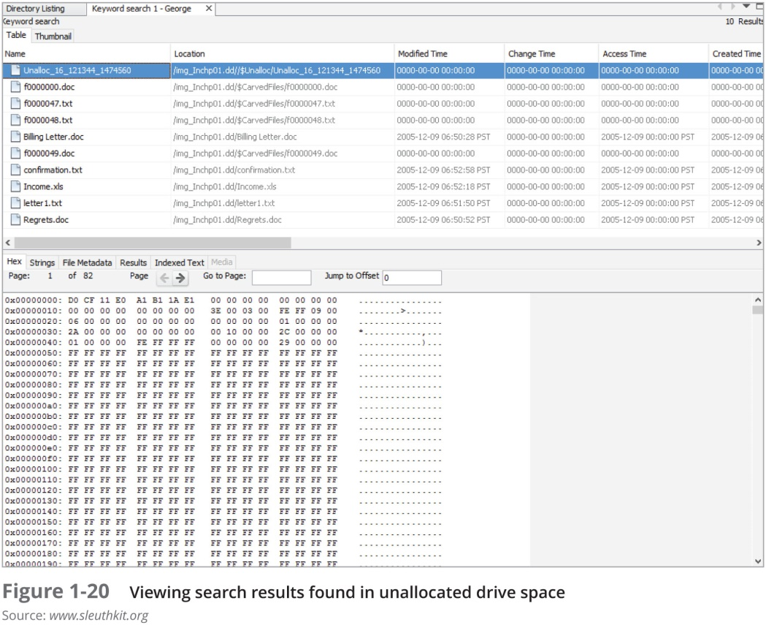
Analyzing Your Digital Evidence (6/8)

Slide 30
Completing the Case (1/2)
You need to produce a final report
  State what you did and what you found
Include Autopsy report to document your work
Repeatable findings
  Repeat the steps and produce the same result
If required, use a report template
Report should show conclusive evidence
  Suspect did or did not commit a crime or violate a company policy

Slide 31
Completing the Case (2/2)
Keep a written journal of everything you do
  Your notes can be used in court
Answer the six Ws:
  Who, what, when, where, why, and how
You must also explain computer and network processes
Autopsy Report Generator
  Can generate reports in different styles: plain text, HTML and Excel

Slide 32
Critiquing the Case
Ask yourself the following questions:
  How could you improve your performance in the case?
  Did you expect the results you found? Did the case develop in ways you did not expect?
  Was the documentation as thorough as it could have been?
  What feedback has been received from the requesting source?
  Did you discover any new problems? If so, what are they?
  Did you use new techniques during the case or during research?

Slide 33
Tool Requirements
Usability - Present data at a layer of abstraction that is useful to an investigator
Comprehensive - Present all data to investigator so that both inculpatory and exculpatory evidence can be identified
Accuracy - Tool output must be able to be verified and a margin of error must be given
Deterministic - A tool must produce the same output when given the same rule set and input data.
Verifiable - To ensure accuracy, one must be able to verify the output by having access to the layer inputs and outputs. Verification can be done by hand or a second tool set.
Brian Carrier, 2003, Defining Digital Forensic Examination and Analysis Tools Using Abstraction Layers

Slide 34
Challenges in Digital Forensics
  Size of storage devices
  Embedded flash devices
  Proliferation of operating systems and file formats
  Multi-device analysis
  Pervasive Encryption
  Cloud computing
  RAM-only Malware
  Legal Challenges decreasing the scope of forensic investigations

